Slide 1
SMART HOSPITAL SYSTEM
SUPERVISED BY
MR. MOHAMMAD MAHADI HASAN
ASSOCIATE PROFESSOR
DEPT. OF CSE, IIUC
PRESENTED BY :
MD. SARWAR UL ISLAM - C143046
MD. RAYHAN MAHMUD - C143047
KAZI MD. SAIFUL ARFIN - C131035

Slide 2
OUTLINE
Introduction
Motivation
Objective
Previous Works
Advantages
Methodology
Requirements
Diagrams
Implementation
Limitation
Future Scope
Conclusion

Slide 3
Introduction
Public health Care and modernization of the hospital management system always been inter related with each other. According to increasing number of populations as well as patients and increasing number of medical challenges hospital’s management systems are upgraded day by day.
To maintain this speed we need a robust management system architecture. The rapid rise of Internet of things has provided a new way of thinking with a lots of new ideas.
The revolutions of automation provides a strong platform to develop the hospital’s information management as well. If we imagine the past hospital services and it’s management system we get the slow and much more complicated image .
But when the questions is about the emergency then less time and quick and simple work ﬂow is needed. But the existing hospital management system cannot provide eﬃciency in this ﬁeld .For this reason many life loses and cost with complication increases .
To reduce this problems and build a robust health care and hospital system we need to relay on advantages of modern web technology.

Slide 4
Motivation
Health care sector is a very important sector for us.
If it is not managed properly it can result in chaos and more importantly it even can lead to death of human lives.
For the sophisticated nature of this sector we wanted to contribute to this sector with skills we have acquired.
Smart Hospital System is the first step towards this approach through which we have tried to make a robust system for managing every section of a hospital.

Slide 5
Objective
To find a donor within a specific area.
Managing fixed donors for patients that needs blood periodically.
Make the donor management process smoother.
Improve the availability of blood donors.
Making the system more donor friendly. So that, they are encouraged to register as donor.

Slide 6
Previous Work
In the previous systems there are no location based donor search option.
There are no fixed donor booking feature in existing system.
There is no agent option in existing systems.
In majority system, there are no super admin feature.

Slide 7
Advantages of our system
In our system we have location based donor search system. In here the patient just input the blood group and the city location. Then the system automatically search the closest donor in the system.
In our system we have the super admin option. Where admin can login in with email and password. The super admin can know all the information. The number of donors, number of patients and the number of agents all the information will be shown in the super admin panel
We included the agent sign up feature. In here the agent can receive the request form any patients for blood. The agent can manage the blood request then he will contact with them manually.
In some case patient needs the donor after a fixed period of time. So, in our system any patient can send request to a donor and if the donor accepts the request then he will be a fixed donor to that patient.

Slide 8
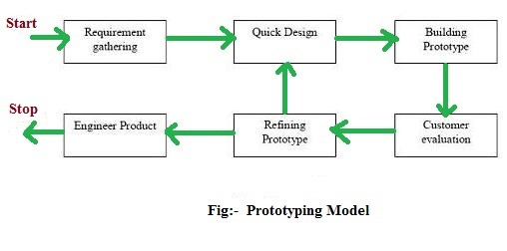
Methodology
Fig: Prototype Model

Slide 9
Methodology
Why we choose prototype model:
In this type of system, one module is made after another.
As per the rules of the prototype model, first we need to make a demo, then show the demo to the client. Then make necessary changes if required.
This is helpful for us as we can get new requirement/s and implement it real soon.
This model is similar to our system and the process is same. That’s why we choose the prototype model.

Slide 10
Requirements
Hardware Requirements
Processor RAM Disk Space 512 Mb or Higher 130 Mb Pentium IV, Dual core, Core 2 duo or higher Software Requirements
Processor: Intel core 2 Dou, Core i3 or higher
Ram: 2 GB

Slide 11
Requirements
User Characteristics
Every user should be:
Comfortable of working with computer.
He should have knowledge about blood donation.
He must also have basic knowledge of English too

Slide 12
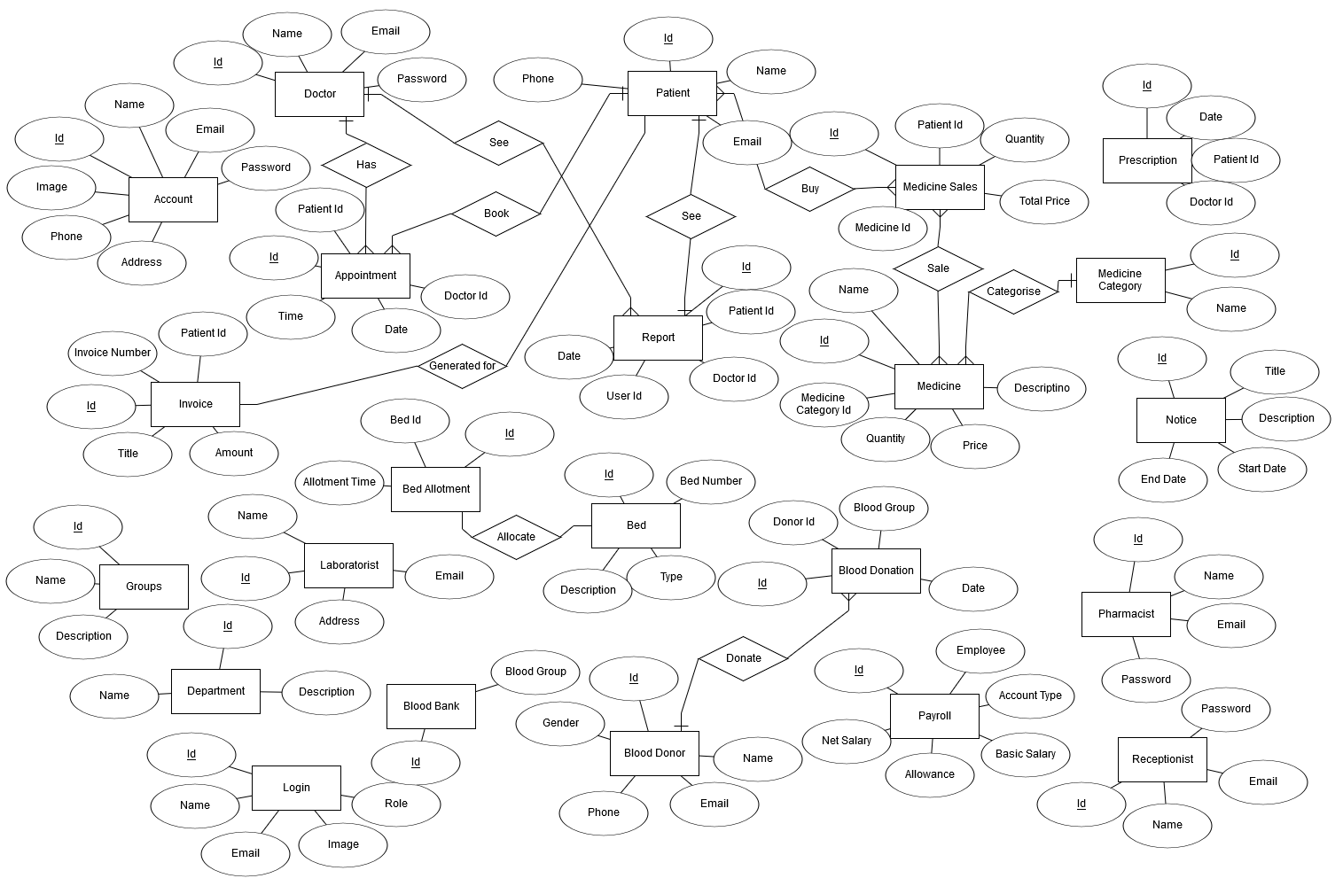
ER Diagram
Fig: ER Diagram

Slide 13
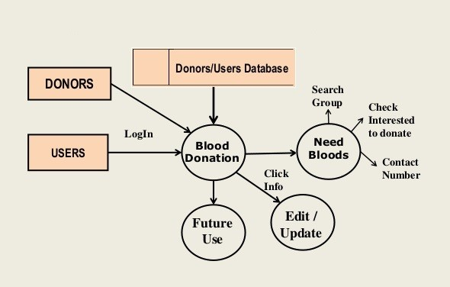
Data Flow Diagram
Fig: Data Flow Diagram

Slide 14
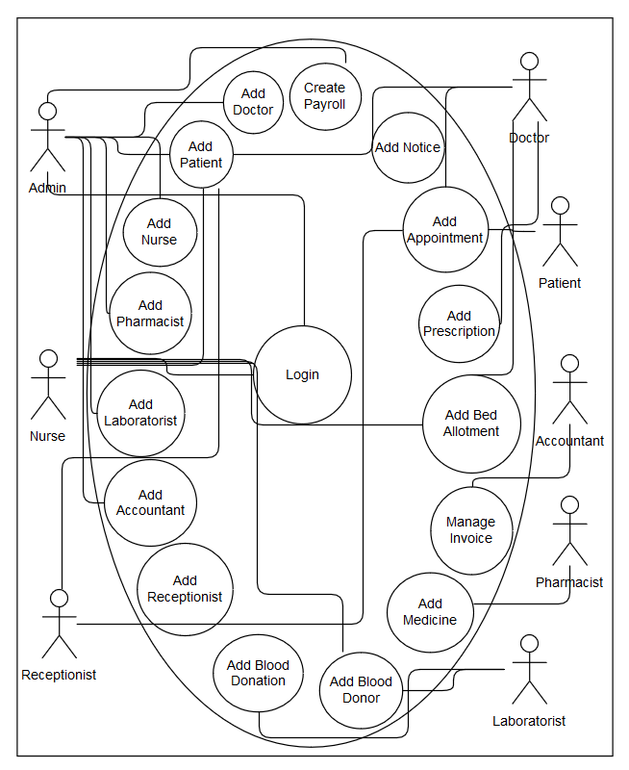
Use Case Diagram
Fig: Use Case Diagram

Slide 15
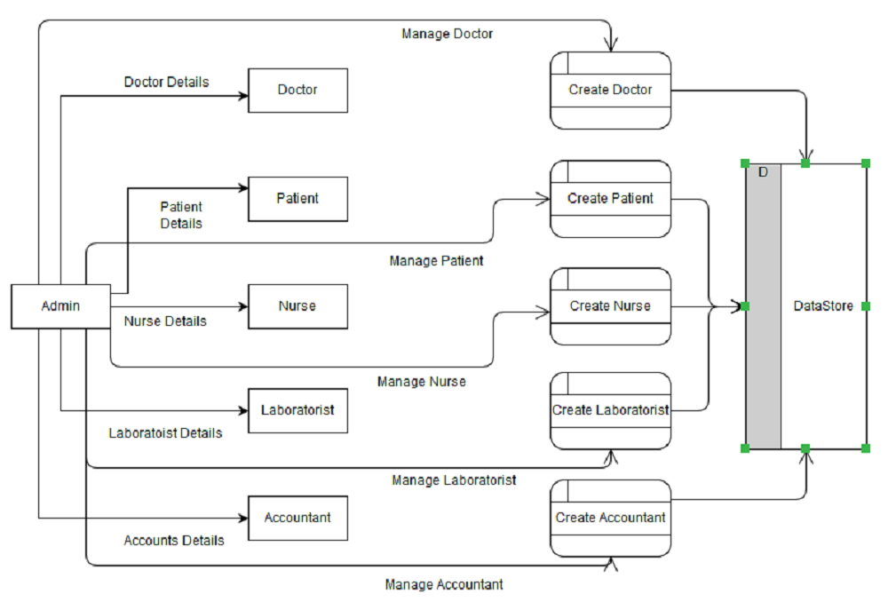
DFD
Fig: Activity Diagram

Slide 16
Implementation
HTML:
We have used HTML5 for our project.
HTML 5 includes detailed processing models to encourage more interoperable implementations.
It extends, improves and rationalizes the markup available for documents, and introduces markup and application programming interfaces (APIs) for complex web applications.
HTML 5 is also a candidate for cross-platform mobile applications, because it includes features designed with low-powered devices in mind.

Slide 17
Implementation
HTML:
To enrich the semantic content of documents, new page structure elements such as <main>, <section>, <article>, <header>, <footer>, <aside>, <nav>, and <figure> are added in HTML5.
It handles multimedia and graphical content, the new <video>, <audio> and <canvas> elements were added, and support for scalable vector graphics (SVG) content, which was lacking in its predecessor HTML4.
The APIs and Document Object Model (DOM) are now fundamental parts of the HTML 5 specification and HTML 5 also better defines the processing for any invalid documents.

Slide 18
Implementation
CSS:
We have used CSS3 for our project.
Unlike CSS2, which was comprised of a single document, CSS3 has its specifications divided into many individual modules, which makes CSS3 a whole lot easier to handle.
With CSS3, the designers can now use special fonts, like those available in Google Fonts and Typecast. Earlier, with CSS and CSS2, designers could only use “web safe fonts” for being 100% sure to use fonts that would always display the same on every machine.
CSS3 has the capability to split text sections into multiple columns so that it can be read as a newspaper. In CSS2, the developers had difficulty because the standard was not equipped with automatically breaking of the text so that it fits within a box.
CSS3 introduced several modules including Media Queries, which makes it easier to make our designs responsive for different device size.

Slide 19
Implementation
Bootstrap:
We have used Twitter Bootstrap 4 for our frontend implementation. And for good reasons such as:
Revolutionary grid system. It is built on responsive 12-column grids, layouts and components. Offsetting & Nesting of columns is also possible in both fixed and fluid width layouts.
All fundamental HTML elements have been styled and enhanced with extensible classes.
It has an extensive list of components. Whether we need drop down menus, pagination or alert boxes, Bootstrap has got us covered.
The latest Bootstrap has so much support for utilities that, it has increased the development speed dramatically.

Slide 20
Implementation
PHP:
We have used PHP as the main language to build our system backend. And for good reasons such as:
Easy and quick start
Simplistic nature and cross platform availability
PHP is language created for web
Community and resources
Hosting availability

Slide 21
Implementation
MySQL:
We have used MySQL for the database to build our system. And for good reasons such as:
MySQL is considered proven
Less maintenance
MySQL is scalable
Great transactional support
RDBMS support

Slide 22
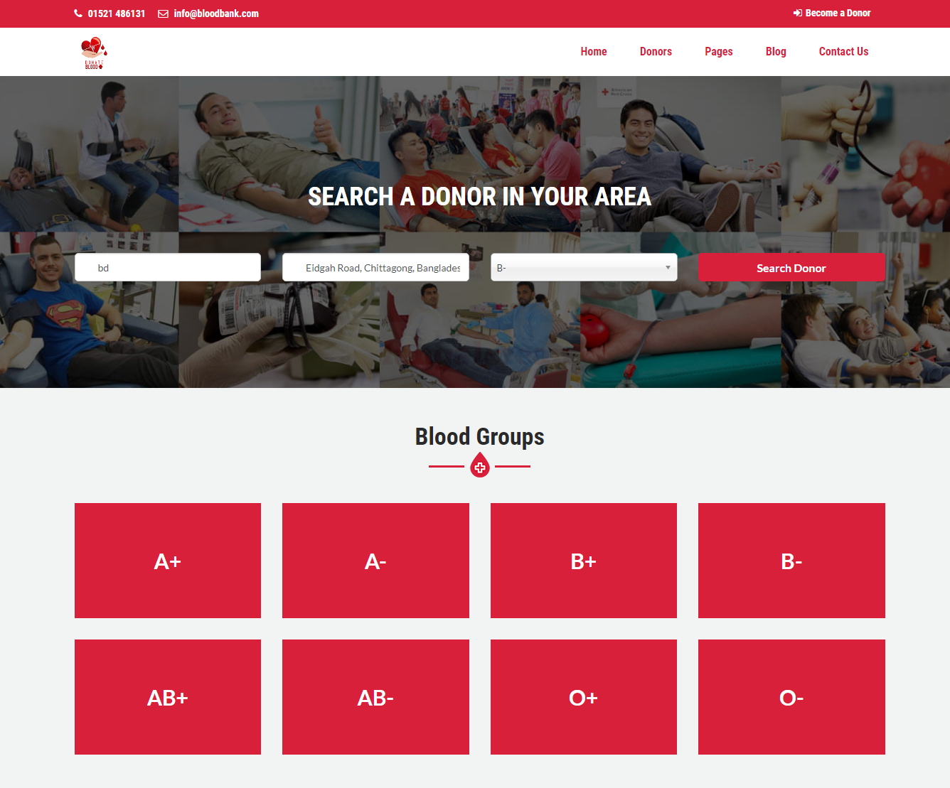
Screenshots
Fig: Homepage – Part 1

Slide 23
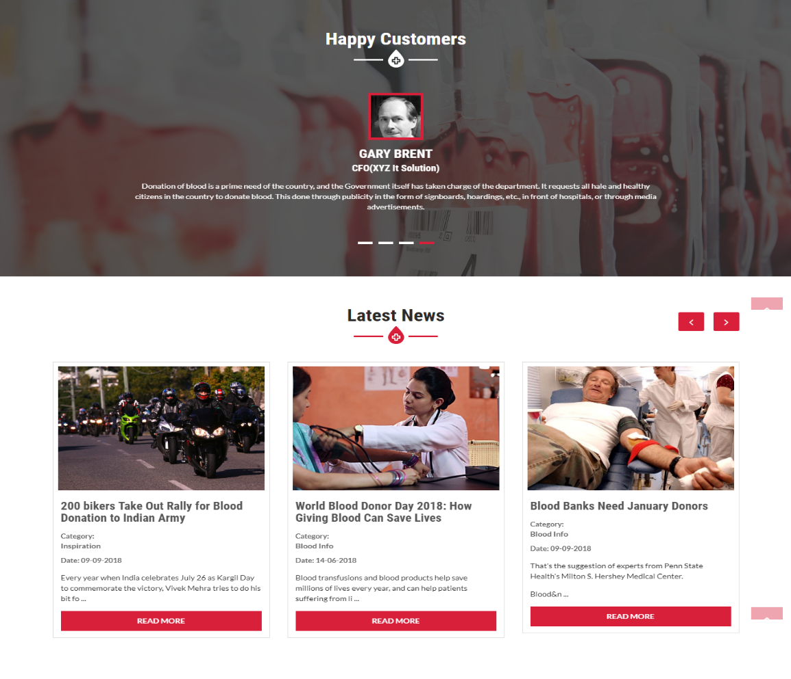
Screenshots
Fig: Homepage – Part 2

Slide 24
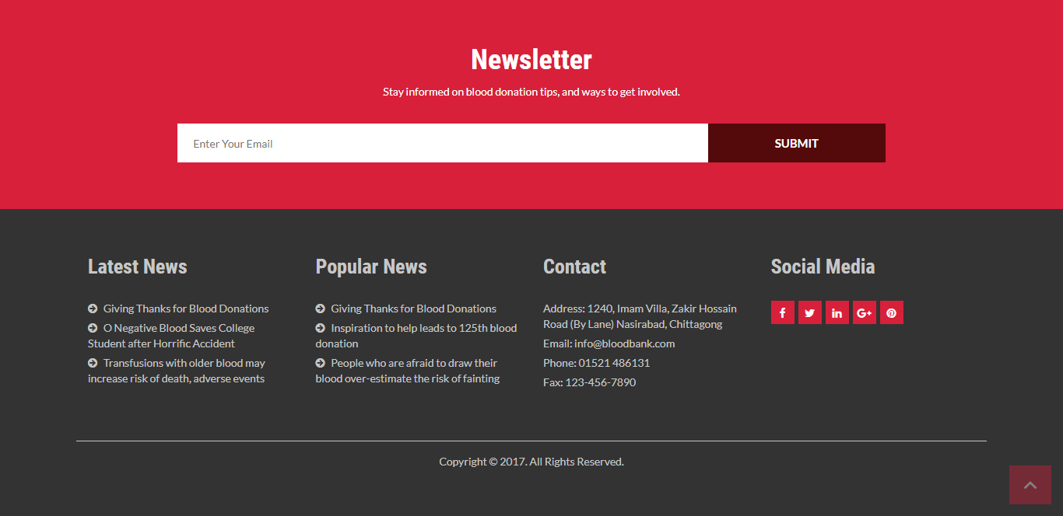
Screenshots
Fig: Newsletter

Slide 25
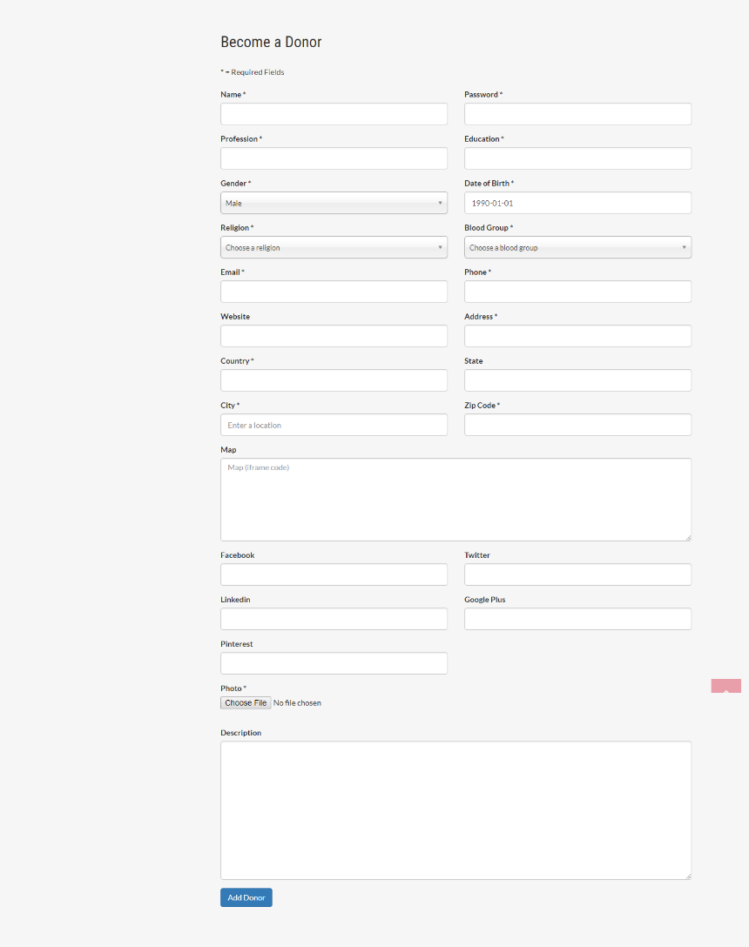
Screenshots
Fig: Become A Donor Page

Slide 26
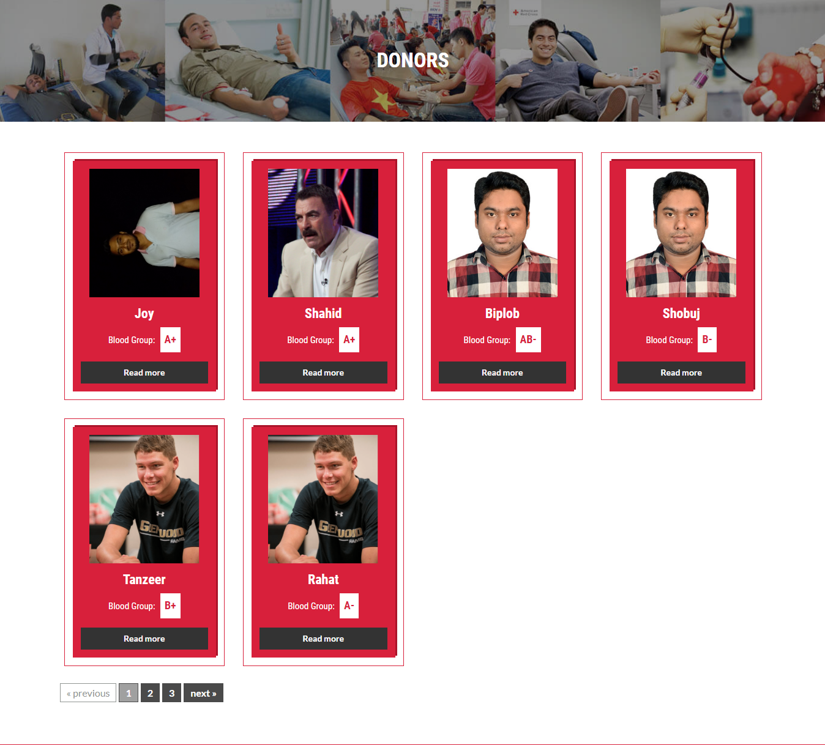
Screenshots
Fig: All Donors Page

Slide 27
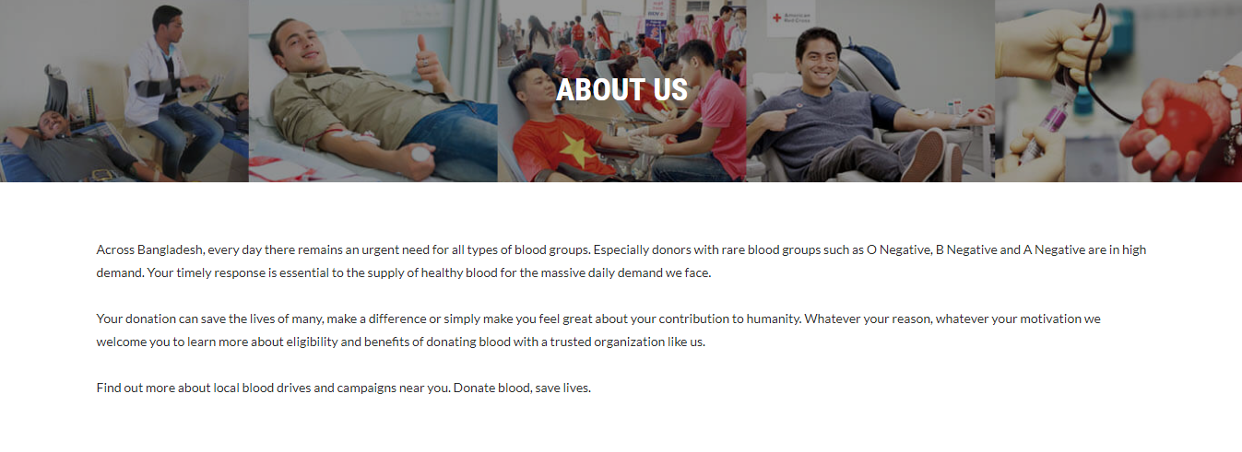
Screenshots
Fig: About Us Page

Slide 28
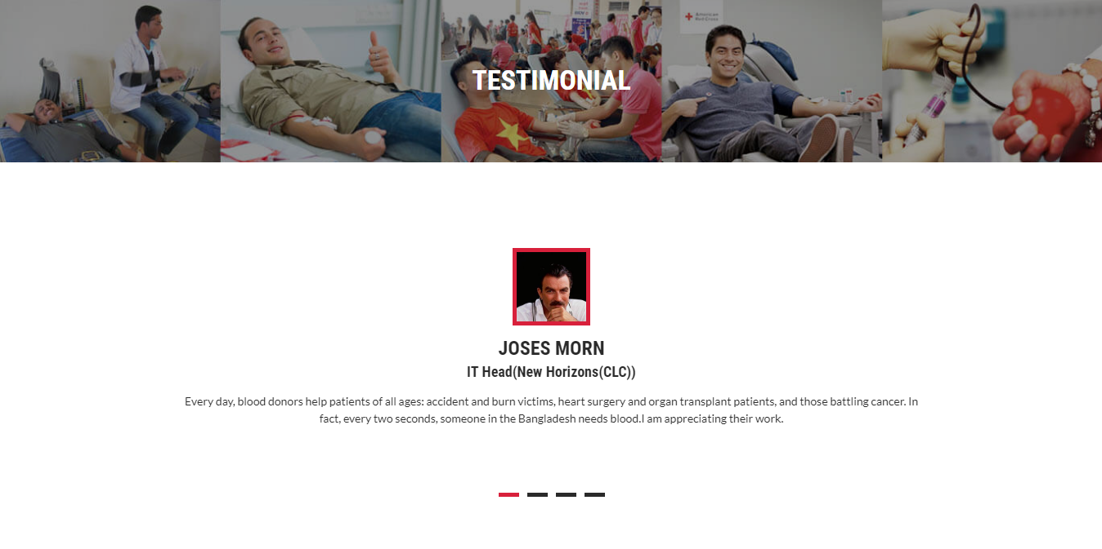
Screenshots
Fig: Testimonial Page

Slide 29
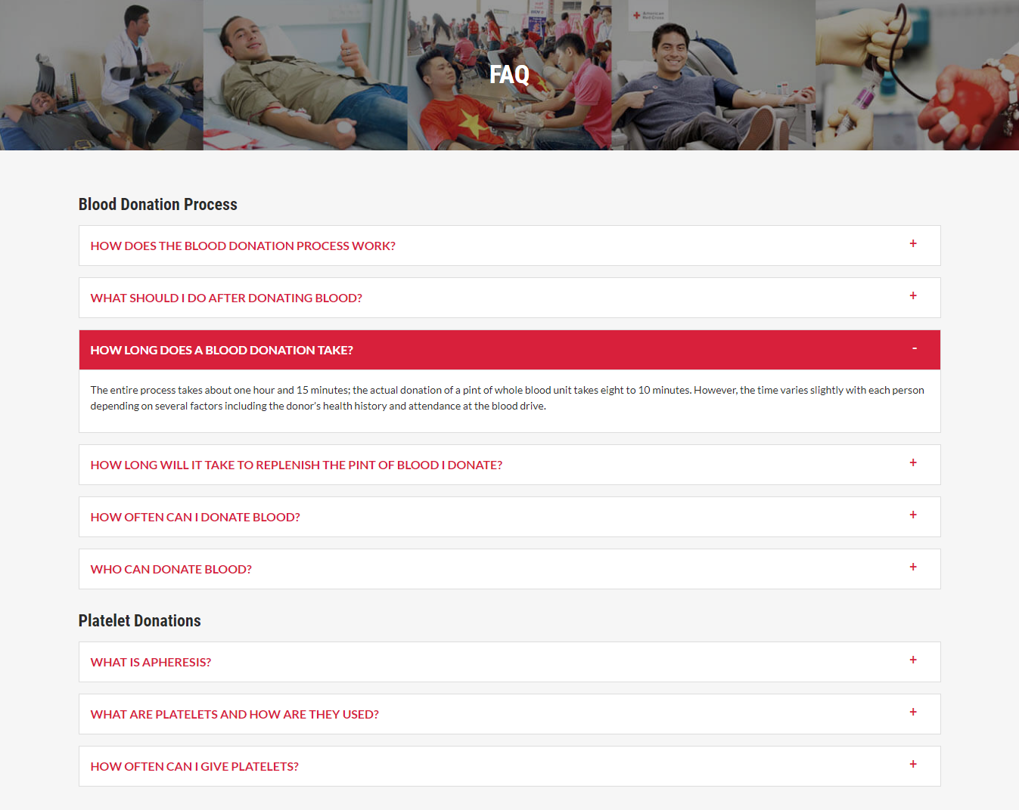
Screenshots
Fig: FAQ Page

Slide 30
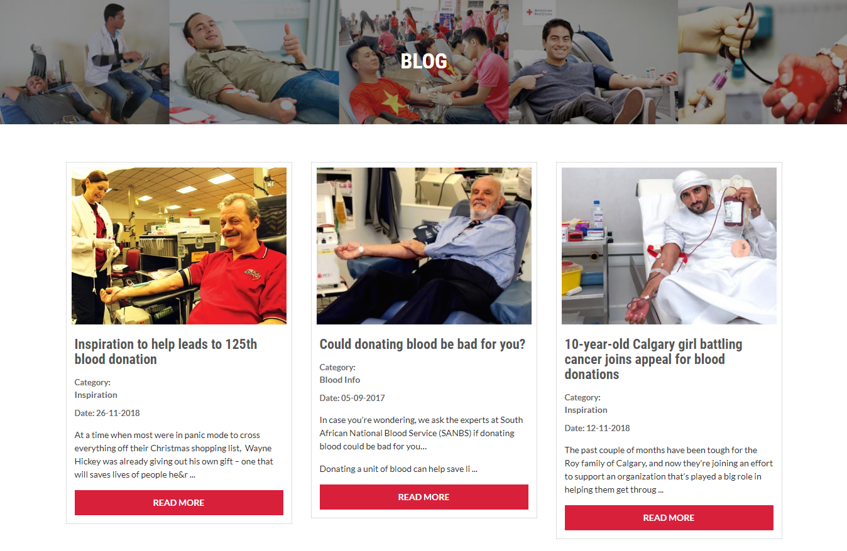
Screenshots
Fig: Blog Page

Slide 31
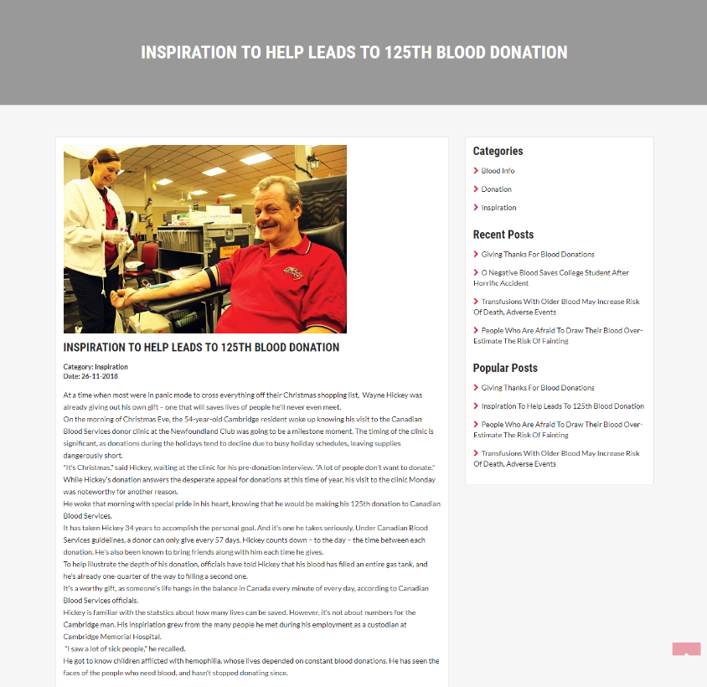
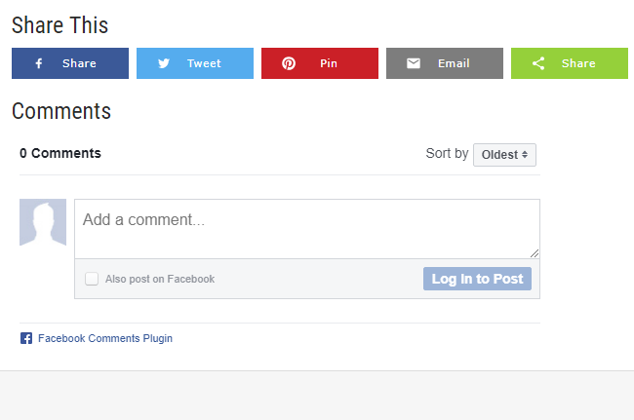
Screenshots
Fig: Single Blog Post

Slide 32
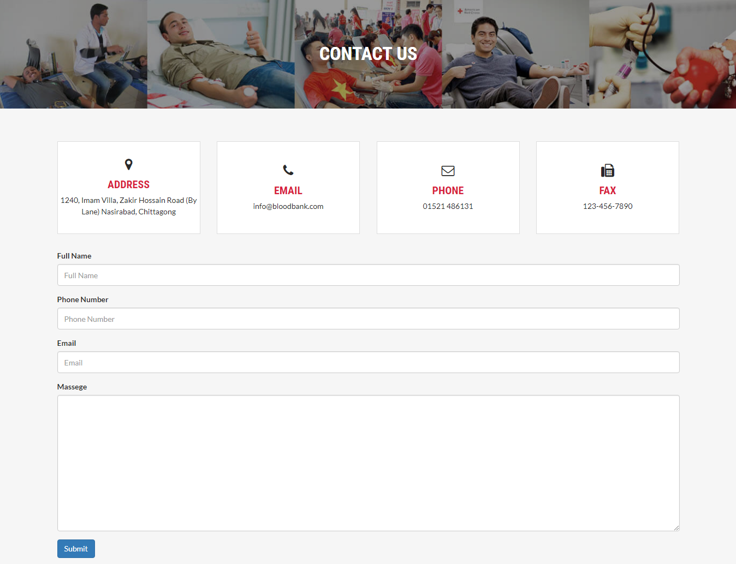
Screenshots
Fig: Contact Page

Slide 33
Limitation
Need internet connection.
The primary language used is English, which might be slightly difficult for people who do not know basic English.
This system requires a minimal literacy of using internet.

Slide 34
Future Plan
We will integrate the system with hospitals.
Introduce a mobile app for our system.
Introduce a broadcast message system such that users can request for blood and relevant donors will get notified and respond to it.

Slide 35
Conclusion
In this system we try our best to make the system very robust and easy to use.
Using this project we can easily find out blood donor of specific group within our desired location.

Slide 36
References
www.google.com
www.wikipedia.com
www.americanredcross.com
www.getbootstrap.com
www.php.net
www.mysql.com
www.javascript.com
www.jquery.com

Slide 37


